Slide 1
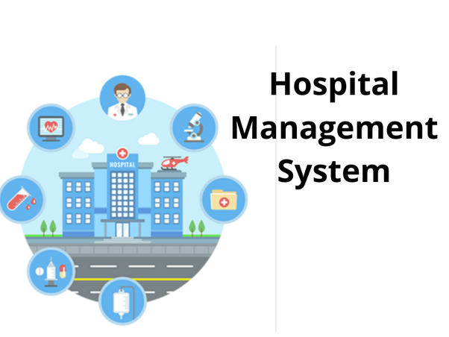

Slide 2

WHY DOES HOSPITAL MANAGEMENT IS NECESSARY

Slide 3
REQUIREMENTS
To computerize all details regarding patient details and hospital details
Scheduling the appointment of patient with doctors to make it convenient for both

Slide 4
Scheduling the services of specialised doctor
and emergency properly so that facilities
provided by hospital are fully utilised
If the medical store issues medicine to
patients, it should reduce the stock status
of the medical store and vice-versa
The inventory should be updated automatically whenever a transaction is made

Slide 5
It should be able to handle the test reports
of the patients conducted in pathology lab of
the hospital
The information of the patients should be
kept up to date and there should be kept in
the system for historical purposes

Slide 6
Thank you

Slide 7
Team members:
J Pavithira
R D Kayal Vizhy
K Pramitha
B R Mounika

